Slide 1
Discovering Graph Neural Networks for Indoor 3D Scene Representation
Thesis Final Presentation :
Student: Fabiola Pasini
Supervisor: Federico Tombari
Advisor: Evin Pınar Örnek, Shun-cheng Wu

Slide 2
Table of Content
Problem
Motivation
3RScan and 3DSSG Dataset
Related Works
Graph Neural Networks
Results
Notes:
First and foremost, depth prediction is fundamental in 3D understanding.
Today, our problem is monocular depth prediction. Given a single RGB image, predict the depth values per each pixel.
Besides being an interesting problem, it regards the industrial applications that are based on 3D scene understanding.
With the availability of many images, it is desirable to reconstruct the 3D representations for AR and VR applications.
In autonomous driving, it can work as a backup to existing lidar based systems. It would also reduce the costs. (one camera versus two)
Likewise, robot navigation, path planning, moving (grabbing objects) … are based on depth understanding.
When the problem arose in 80s, first attempts were based on inferring shape from monocular cues like shade or texture.
But they did not solve the problem accurately.
Because it is a very underconstrained problem, many solutions exist for a single view. There are no geometrical constraints.
People can infer depth from a single view succesfully, because we have prior knowledge about the World.
These factors make our problem very suitable for deep learning.
Especially now, there are many images, huge datasets and higher computational power.

Slide 3
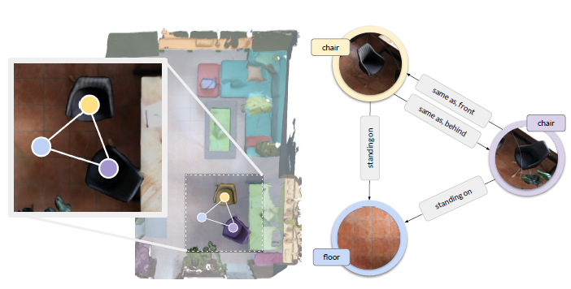
Problem
Purpose:
Predict a scene graph from a segmented point cloud.
Problem:
Build a new GNN implementation that takes care not only of the node feature but also of the edge feature,
Try the newest GNN architectures proposed in the last years,
Compare the new result with the older ones.
[1] Wald, Johanna and Dhamo, Helisa and Navab, Nassir and Tombari, Federico. Learning 3D Semantic Scene Graphs from 3D Indoor Reconstructions. Proceedings IEEE Conference on Computer Vision and Pattern Recognition(CVPR), 2020

Slide 4
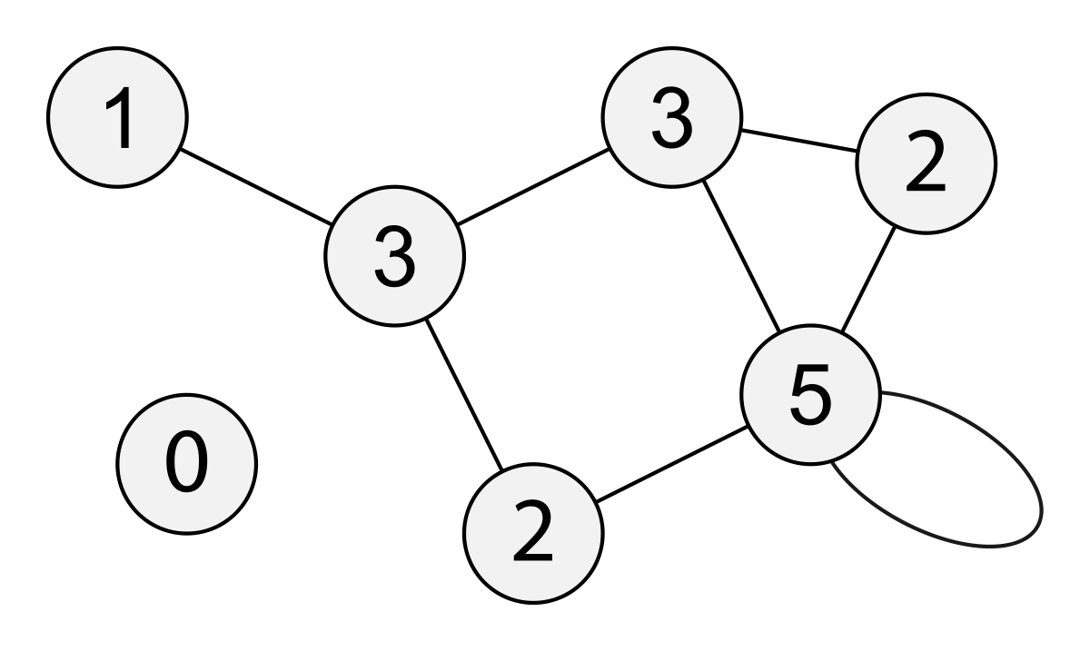
Motivation
Scene graphs is graph representation of a scene which useful in computer vision as we can describe a scene as set of nodes (objects) and edges (relationship between them).
Graph neural networks are recent research field originally applied to:
Social nets
Molecular representation and biology
The previous implementations don’t take care of the edge features
In scene graphs edges carry features , i.e «attached to» or «hanging on»
Source: https://en.wikipedia.org/wiki/Degree_(graph_theory)

Slide 5
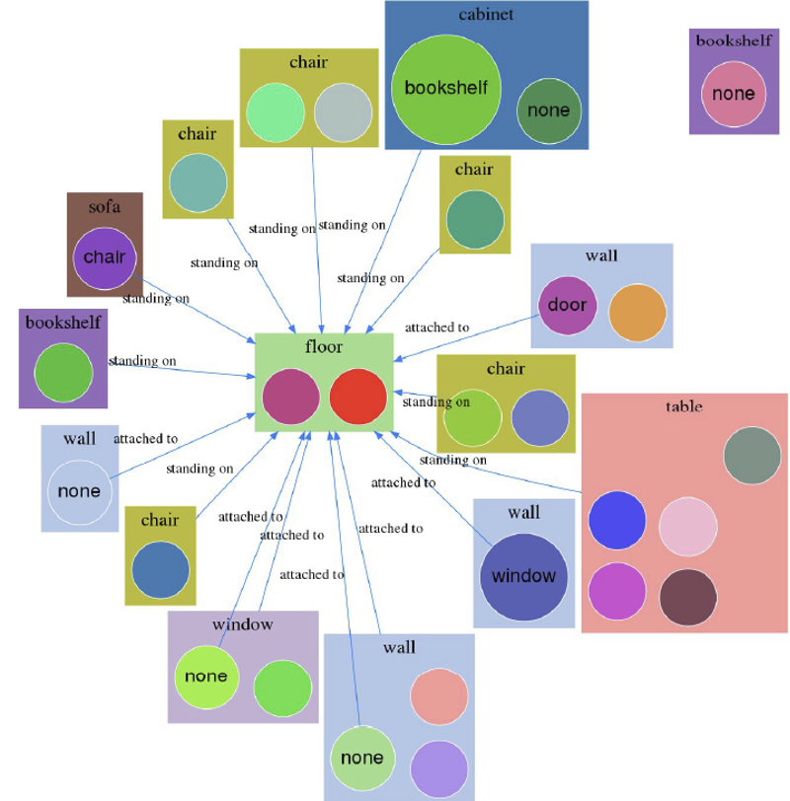
Desired result
[2] Shun-Cheng Wu and Johanna Wald and Keisuke Tateno and Nassir Navab and Federico Tombari. SceneGraphFusion: Incremental 3D Scene Graph Prediction from RGB-D Sequences. Proceedings IEEE Conference on Computer Vision and Pattern Recognition (CVPR), 2021

Slide 6
Dataset

Slide 7
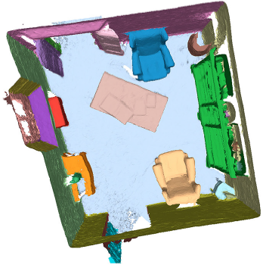
3RScan dataset
A large scale, real-world dataset which contains:
1482 3D reconstructions
for 478 naturally changing indoor environments.
[3] Wald, Johanna and Dhamo, Helisa and Navab, Nassir and Tombari, Federico. Learning 3D Semantic Scene Graphs from 3D Indoor Reconstructions. Proceedings IEEE Conference on Computer Vision and Pattern Recognition(CVPR), 2020

Slide 8
3DSSG dataset
Nodes (3D object instances in a 3D scan) defined by:
Semantics,
Hierarchy of classes,
Attributes that describe the visual and physical appearance of the object,
Affordances.
The edges represent 40 different relationship.
The dataset features:
1482 scans
48k object nodes
544k edges
For the training:
160 classes
27 relationship

Slide 9
Related works

Slide 10
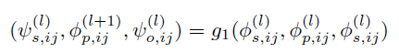
Graph Convolution Layer
Concatenate v_s (current node), v_r (the edge) and v_o (neighbour),
Feed the new tensor in a multilayer perceptron g₁(.) for information propagation
Split the resulting vector to get v_s’, v_r’ and v_o’.
[4] Johnson, Justin and Gupta, Agrim and Fei-Fei, Li. Image Generation from Scene Graphs, CVPR, 2018

Slide 11
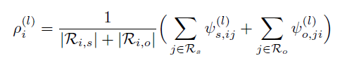
Graph Convolution Layer
The two resulting node features v_s’ and v_o’ are averaged together to get ρᵢ,
Feed the new tensor to a multilayer perceptron g₂(.) .
[5] Johnson, Justin and Gupta, Agrim and Fei-Fei, Li. Image Generation from Scene Graphs, CVPR, 2018

Slide 12
Graph Convolution Layer
Message Passing class from Pytorch geometric,
The first step of the convolution layer is done in the message function,
In the forward method, we call the propagate function and get the results of the message function. Then we apply the second convolution layer,
We use aggr='add’ as the order-invariant aggregation function,
[6] Wald, Johanna and Dhamo, Helisa and Navab, Nassir and Tombari, Federico. Learning 3D Semantic Scene Graphs from 3D Indoor Reconstructions. Proceedings IEEE Conference on Computer Vision and Pattern Recognition(CVPR), 2020

Slide 13
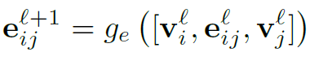
Graph Convolution Layer
Edge features:
Get v_i (subject), e_ij (predicate) and v_j (neighbour),
Concatenate them together,
Feed the new tensor in a multilayer perceptron ge(.),
The output is the updated edge features.
[7] Shun-Cheng Wu and Johanna Wald and Keisuke Tateno and Nassir Navab and Federico Tombari. SceneGraphFusion: Incremental 3D Scene Graph Prediction from RGB-D Sequences. Proceedings IEEE Conference on Computer Vision and Pattern Recognition (CVPR), 2021

Slide 14
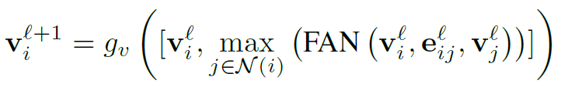
Graph Convolution Layer
Node features:
Feed v_i (subject), e_ij (predicate) and v_j (neighbour) into a FAN function that calculates the attention and apply it to the neighbour node features,
Neighbour node features are aggregated using MAX as aggregation function,
Aggregated node features are concatenated with the node features,
Feed the new tensor in a multilayer perceptron gv(.).
[8] Shun-Cheng Wu and Johanna Wald and Keisuke Tateno and Nassir Navab and Federico Tombari. SceneGraphFusion: Incremental 3D Scene Graph Prediction from RGB-D Sequences. Proceedings IEEE Conference on Computer Vision and Pattern Recognition (CVPR), 2021

Slide 15
Graph Neural Networks

Slide 16
Methodology
Develop and compare different Graph Neural Networks that are able to learn both node features and edge features.
EAN_ms and Graphormer models have been implemented by improving existing models through the integration of networks and classes.
GCN, GraphSAGE and GIN models have been obtained by expanding an existing implementations from PyTorch Geometric, with the addition of rules for encoding edge features.

Slide 17
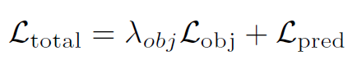
Experiments Setup
Split:
train: 1055
validation: 123
test: 157
Loss:
Objects (L_obj): Cross Entropy
Relationships (L_pred): per-class Binary Cross Entropy
λobj : weighting factor
Epoches: 100
[9] Wald, Johanna and Dhamo, Helisa and Navab, Nassir and Tombari, Federico. Learning 3D Semantic Scene Graphs from 3D Indoor Reconstructions. Proceedings IEEE Conference on Computer Vision and Pattern Recognition(CVPR), 2020

Slide 18
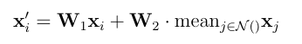
GraphSAGE
Edge features:
Get v_i (subject), e_ij (predicate) and v_j (neighbour) in the message() function of Message Passing class from PyTorch Geometric
Concatenate them together,
Feed the new tensor in a multilayer perceptron ge(.),
The output is the updated edge features.
Node features:
The node features are learnt using GraphSAGE. I used the implementation provided by PyTorch Geomtric and mean as aggregation function,
The resulting tensor is then feed inside a final multilayer perceptron.
[10] Hamilton, William L. and Ying, Rex and Leskovec, Jure. Inductive Representation Learning on Large Graphs, NIPS, 2017.

Slide 19
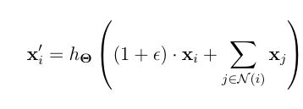
GIN
Edge features:
Get v_i (subject), e_ij (predicate) and v_j (neighbour) in the message() function of PyTorch Geometric,
Concatenate them together,
Feed the new tensor in a multilayer perceptron ge(.),
The output is the updated edge features.
Node features:
The node features are learnt using GIN. I used the implementation provided by PyTorch Geomtric and mean as aggregation function,
The resulting tensor is then feed inside a final multilayer perceptron.
[11] Keyulu Xu and Weihua Hu and Jure Leskovec and Stefanie Jegelka. How Powerful are Graph Neural Networks?, 2019

Slide 20
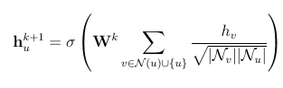
GCN
Edge features:
Get v_i (subject), e_ij (predicate) and v_j (neighbour) in the message() function of PyTorch Geometric,
Concatenate them together,
Feed the new tensor in a multilayer perceptron ge(.),
The output is the updated edge features.
Node features:
The node features are learnt using GCN. I implemented this level from scratch. I used and add as aggregation function,
The resulting tensor is then feed inside a final multilayer perceptron.
h(k+1) = outputs node feature
h(v) = node feature in input
σ(⋅) non-linear activation rule
W is a weight matrix (linear layer in deep learning)
Sqrt(Nv,Nu) is the symmetric normalization
[12] Kipf, Thomas N and Welling, Max. Semi-Supervised Classification with Graph Convolutional Networks, 2016

Slide 21
EAN_ms
This is the same Shun-cheng Wu implementation improved using PyTorch Geometric library.
In the forward function of the Graph Convolution Layer it is called the propagate() function which, in her turn, calls the message() function that returns the updated node and edge features. Then a final MLP is applied to the node features.
Inside the message() is possible to get v_i (subject), e_ij (predicate) and v_j (neighbour). Then neighbour node features are calculated using the same attention mechanism proposed in the Shun-cheng Wu implementation. The edge feature are calculated in the same way as the precoius models.

Slide 22
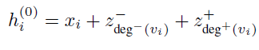
Graphormer pt.1
This is the same EAN_ms implementation improved using different part of the Graphormer network.
Before any other computation, to the node is added the Centrality Bias, which helps in understanding the importance of the node in the graph.
The Centrality Bias is composed of
in_degree
out_degree
[13] Chengxuan Ying and Tianle Cai and Shengjie Luo and Shuxin Zheng and Guolin Ke and Di He and Yanming Shen and Tie-Yan Liu. Do Transformers Really Perform Badly for Graph Representation? Thirty-Fifth Conference on Neural Information Processing Systems,2021

Slide 23
Graphormer pt.2
Edge features are still calculated appling a multilayer perceptron ge(.) to the concatenation of the subject, predicate and neighbour.
Node features are calculated through the attention mechanism improved with PyTorch Geometric.
Then to the node feature is applied a batch normalization and the FeedForward network introduced in Graphormer publication. This network is composed of Linear and Gelu layers. Finally, to the node feature is applied a dropout layer.

Slide 24
Results

Slide 25
Metrics
For evaluating node predictions and relationship redictions I used the IoU Score which is calculated as the number of true positive divided by the addiction of true positive, false positive, false negative.
For evaluating Triplets I used a top-n evaluation metrics to evaluate most confident (subject, predicate, object) triplets against the ground-truth.

Slide 26
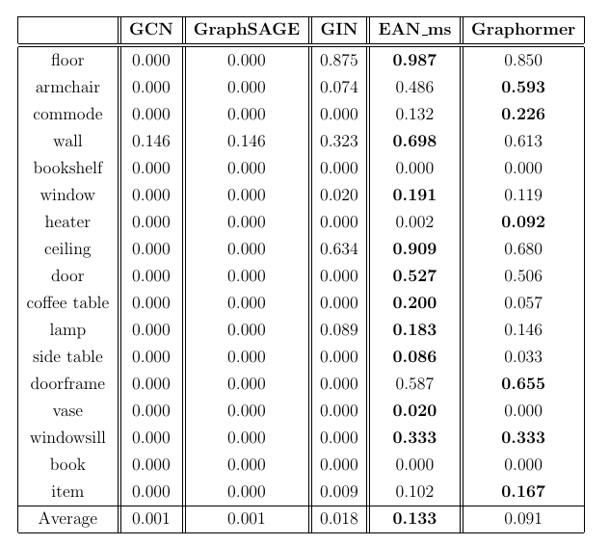
IoU objects result and analysis

Slide 27
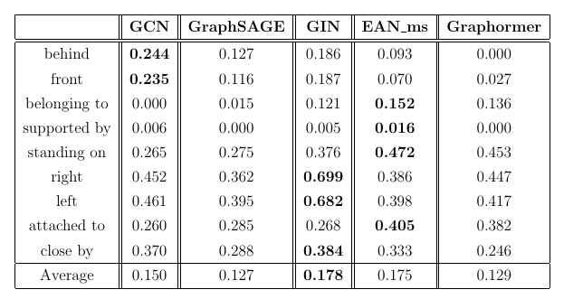
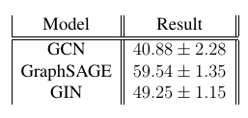
IoU predicates result and analysis
[14] Talak, Rajat and Hu, Siyi and Peng, Lisa and Carlone, Luca. Neural Trees for Learning on Graphs, Advances in Neural Information Processing Systems, 2021.

Slide 28
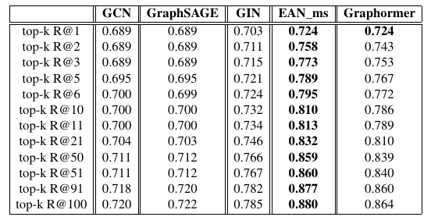
Top-n evaluation for triplets and analysis

Slide 29
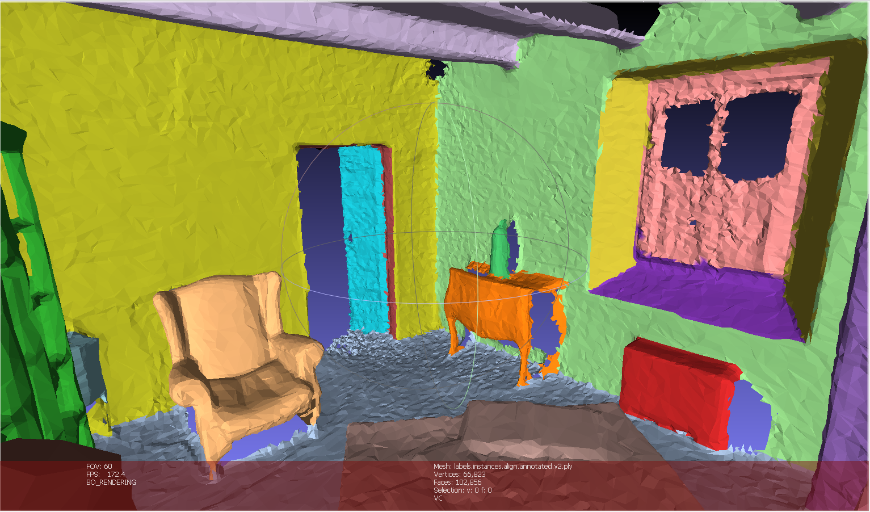
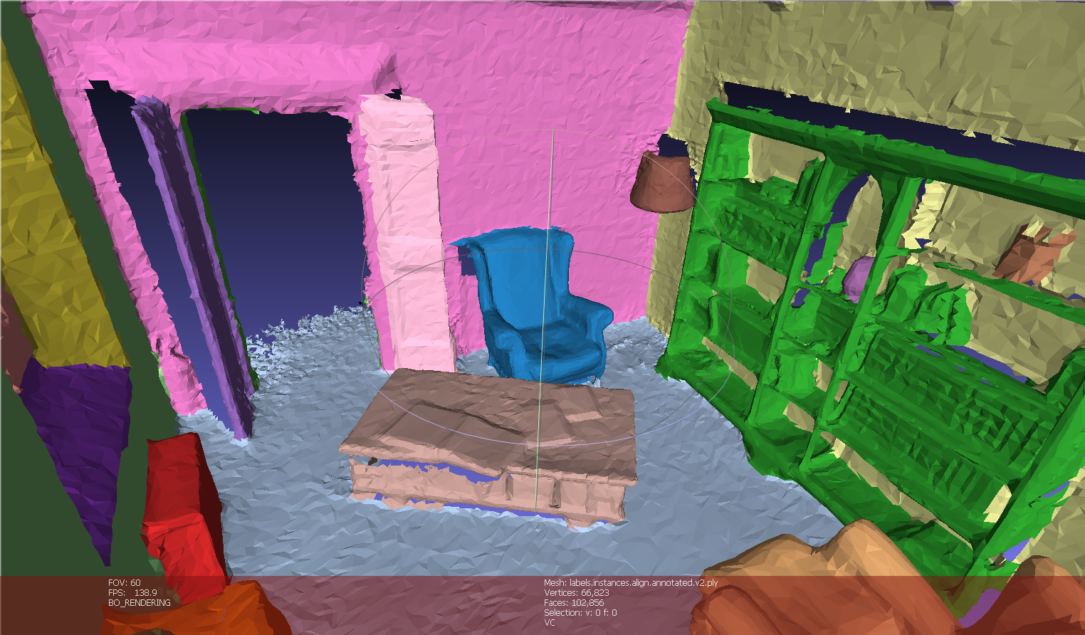
Scan Sample

Slide 30
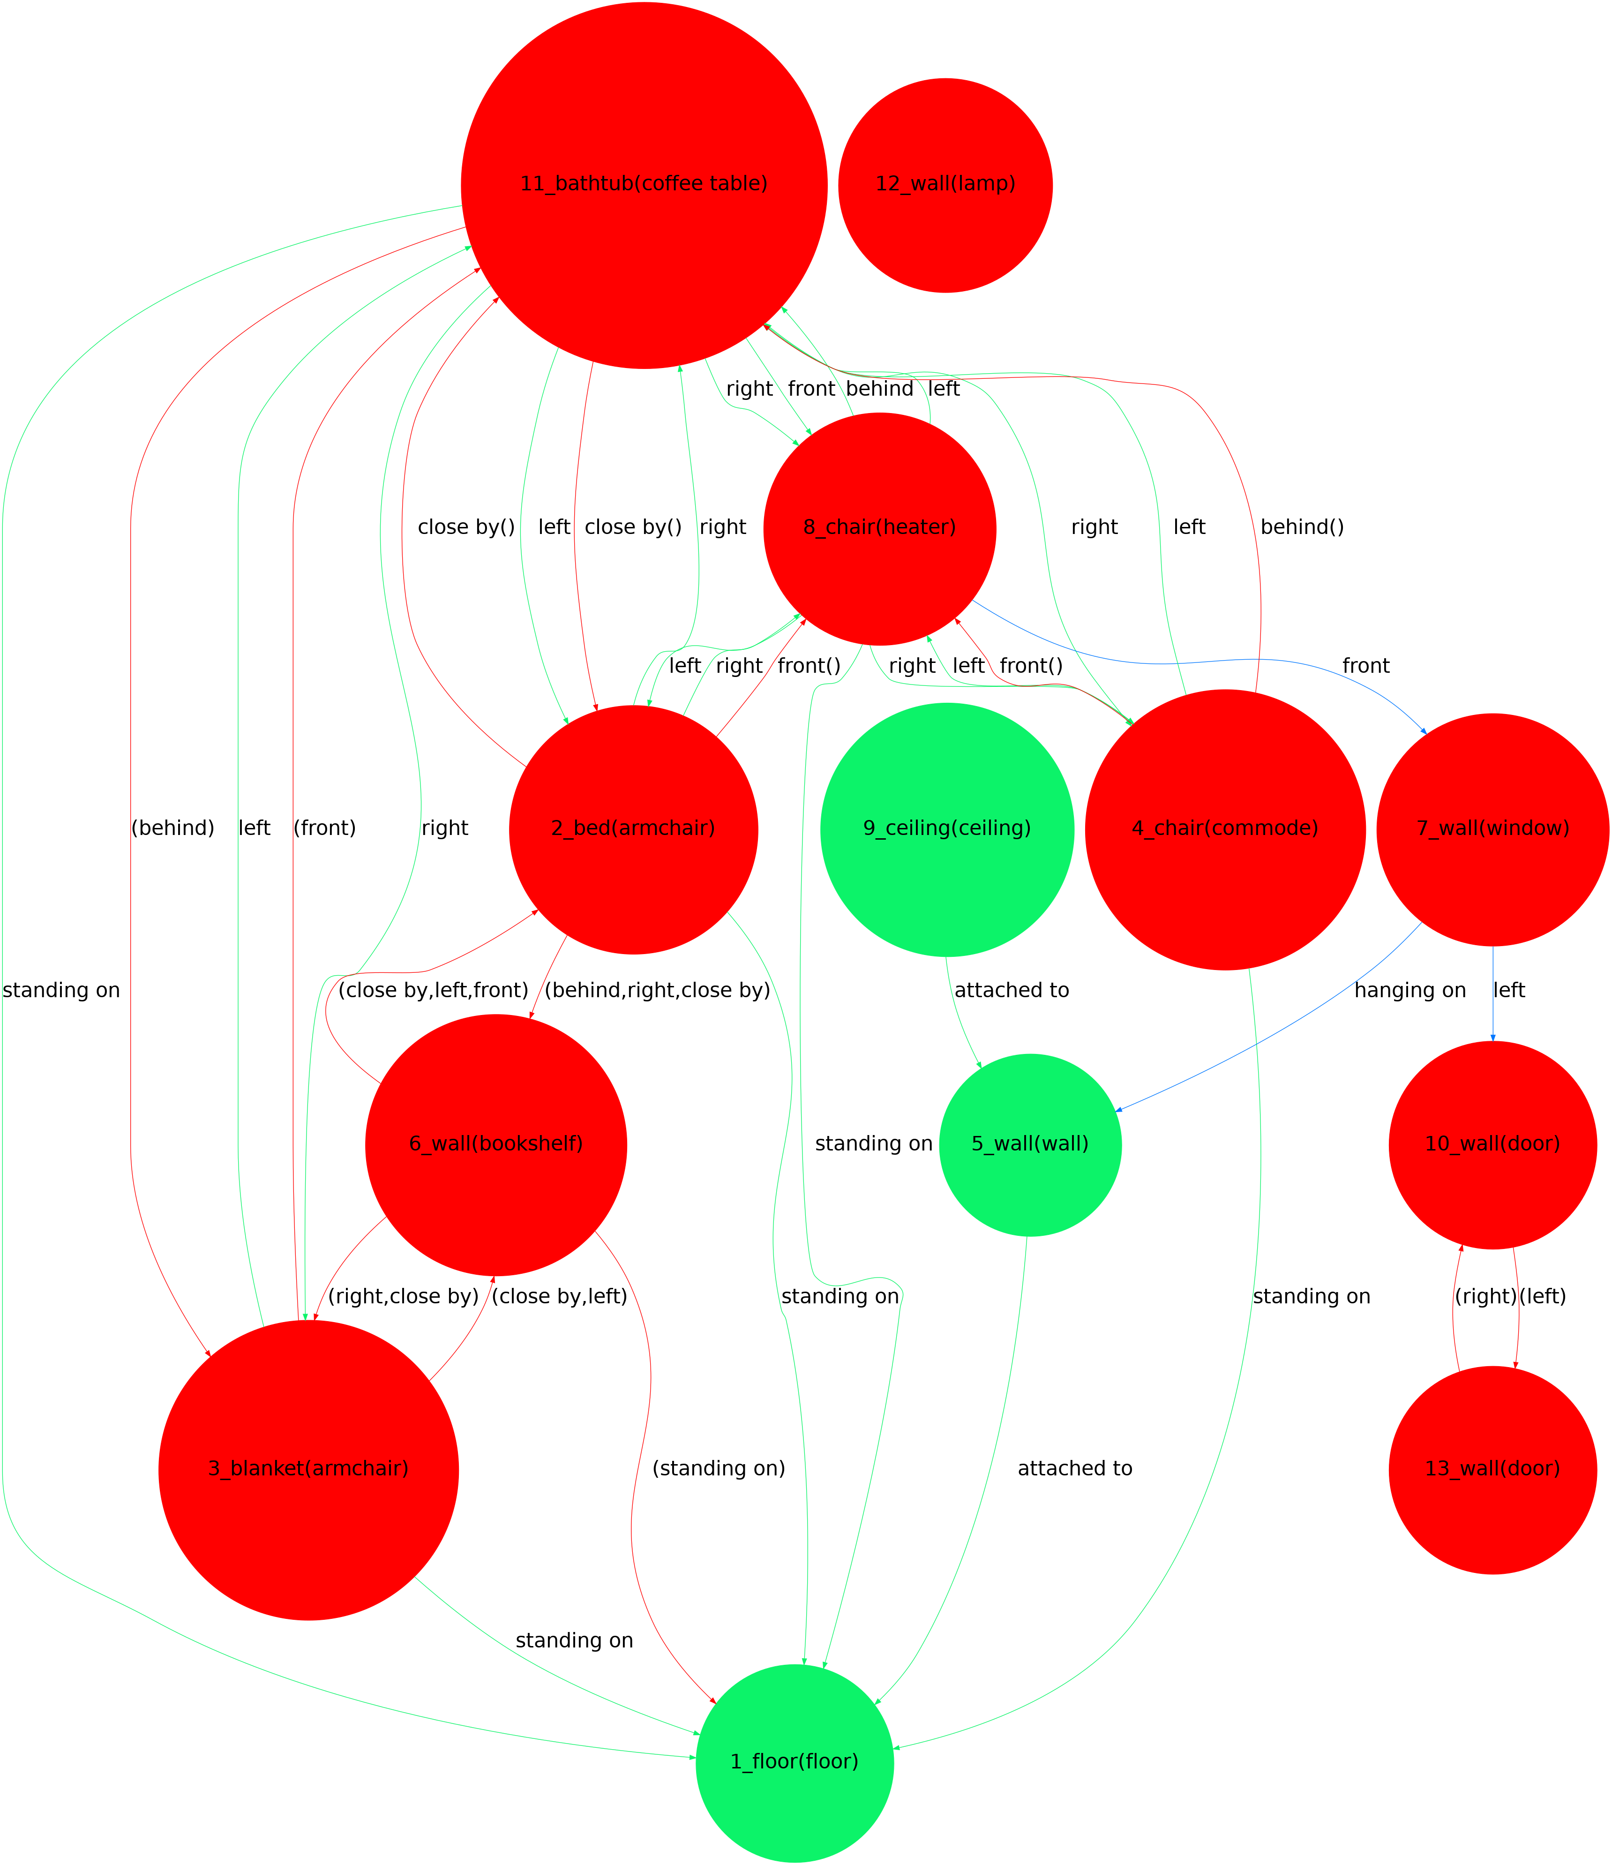
Qualitative Result (GIN, first 13 nodes)

Slide 31
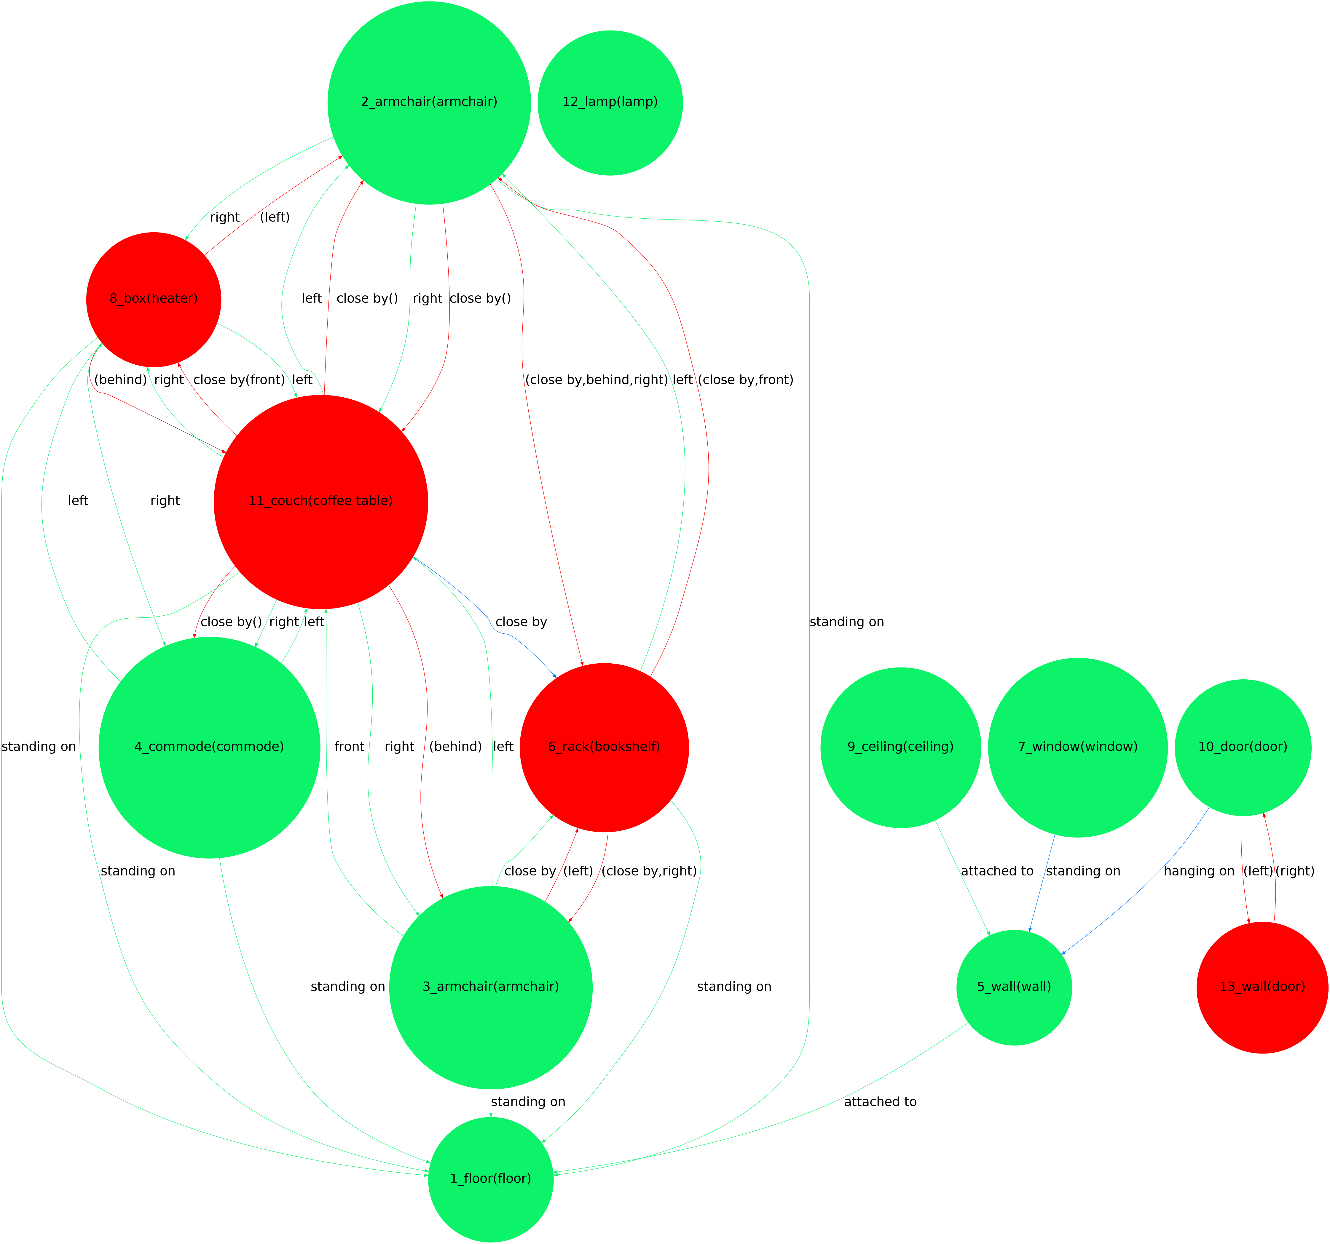
Qualitative Result (EAN_ms, first 13 nodes)

Slide 32
References
Justin Johnson, Agrim Gupta, Li Fei-Fei, Stanford University, Google Cloud AI. Image Generation from Scene Graphs.
Johanna Wald, Helisa Dhamo, Nassir Navab, Federico Tombari, Universität München, Google. Learning 3D Semantic Scene Graphs from 3D Indoor Reconstructions.
Shun-Cheng Wu and Johanna Wald and Keisuke Tateno and Nassir Navab and Federico Tombari. SceneGraphFusion: Incremental 3D Scene Graph Prediction from RGB-D Sequences.
Fey, Matthias and Lenssen, Jan E. Fast. Graph Representation Learning with {PyTorch Geometric} .

Slide 33
Thanks for the attention
fabiola.pasini@tum.de

Slide 34
Appendix

Slide 35
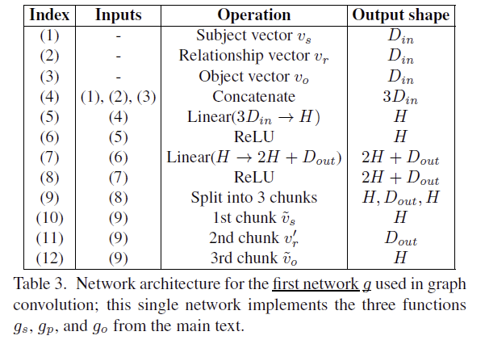
Graph Convolution Layer
[1] Justin Johnson, Agrim Gupta, Li Fei-Fei, Stanford University, Google Cloud AI. Image Generation from Scene Graphs.

Slide 36
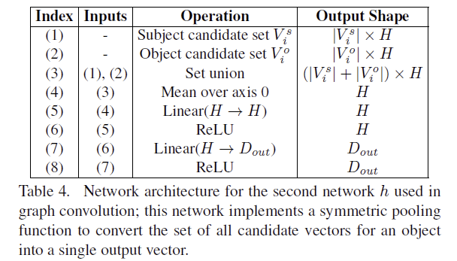
Graph Convolution Layer
[1] Justin Johnson, Agrim Gupta, Li Fei-Fei, Stanford University, Google Cloud AI. Image Generation from Scene Graphs.

Slide 37
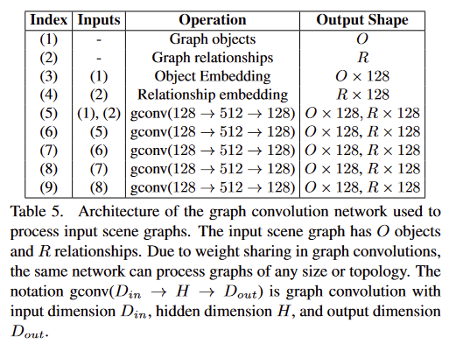
Graph Convolution Network
[1] Justin Johnson, Agrim Gupta, Li Fei-Fei, Stanford University, Google Cloud AI. Image Generation from Scene Graphs.

